Slide 1

Lecture 14
Chemical Engineering for Micro/Nano Fabrication
Wafer
Lamellae
Wafer

Slide 2
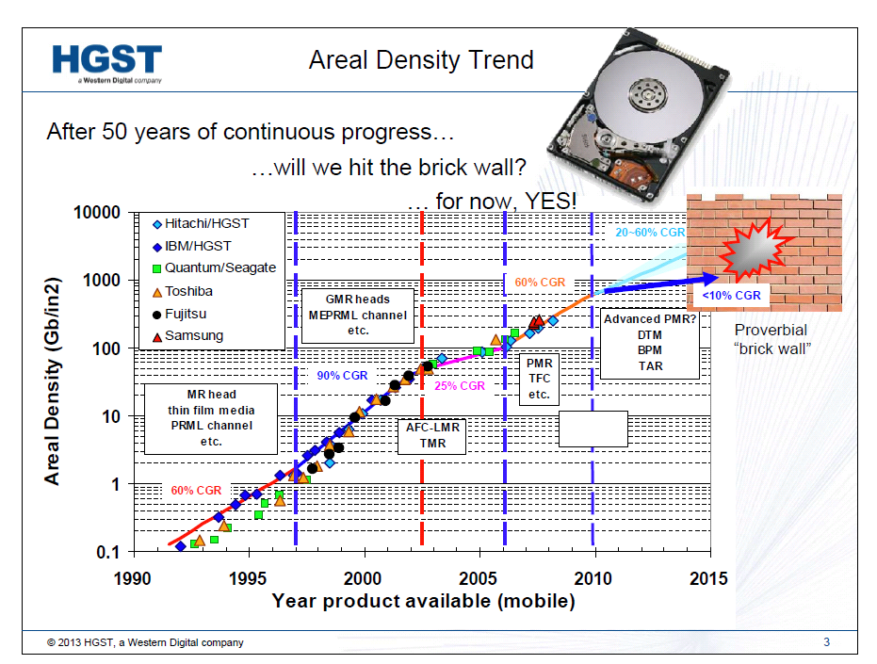

Slide 3
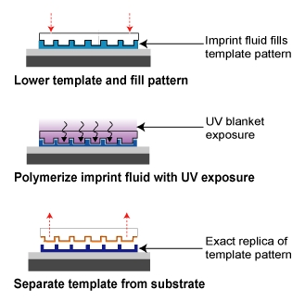
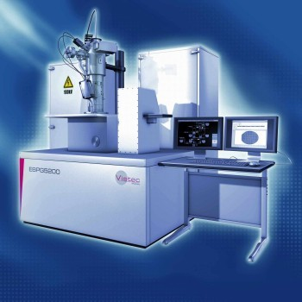
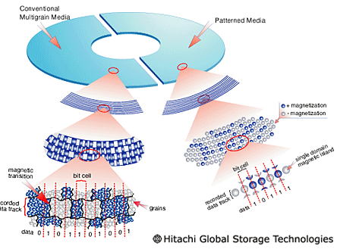
Very Small Features required for New Hard Disk Drives
Electron Beam Lithography
Nanoimprint Lithography
http://www.patrickcarlberg.dk/Lic/Intro%20mm/lith_image2.htm
http://nextbigfuture.com/2009/06/electron-beam-lithography.html
http://www.itmweb.com/bimages/mitechnique.jpg
Lodder, J.C., Journal of Magnetism and Magnetic Materials, 2004. p. 1692-1697.

Slide 4
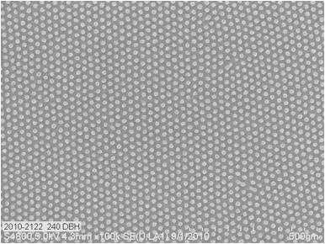
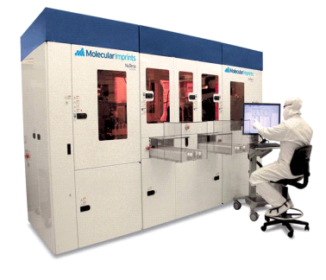
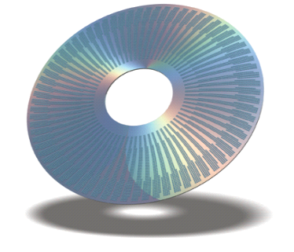


Printing Bit Patterned Media
BPM Disk Imprint
NuTera
TM
HD7000
-
2.5
-
inch Disk
12nm Half Pitch Resist Pillars on Disk
-
From a hole tone template

Slide 5
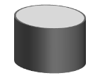

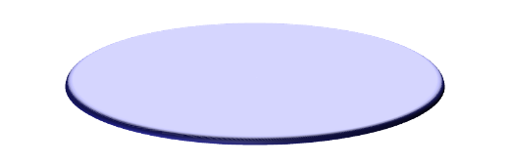


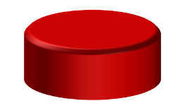
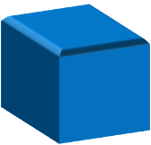


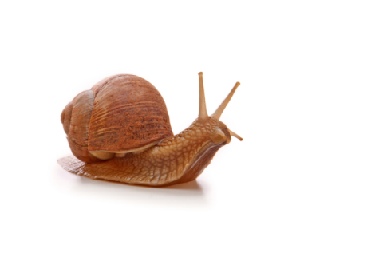
Bad News….we cant make the templates!!
Template Mastering with Rotary E-beam
Electron Gun
Takes ~ 1 month to write one template !!!
Cost ~ $ 10⁶ / template
Master template
Rotating Spindle Stage
Linear Stage
This is just far too Slow!!!
Notes:
5

Slide 6
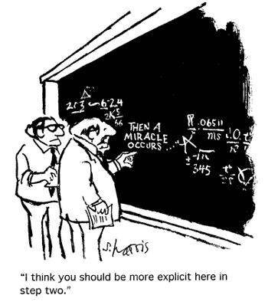

Slide 7
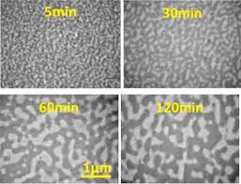
Polymers may offer the Miracle!!
Effect of annealing on blend morphology

Slide 8

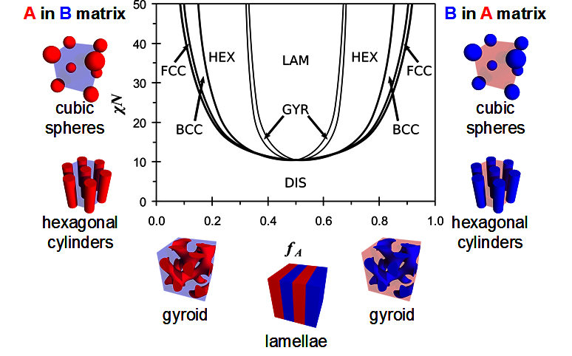

Miracle of Block Copolymers
A
B
Volume Fraction A
Notes:
xN represents the driving force for phase separation
X – interaction parameter, represents energetic penalty of mixing components. Essentially like a solubility parameter

Slide 9
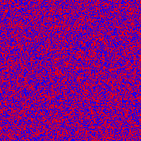
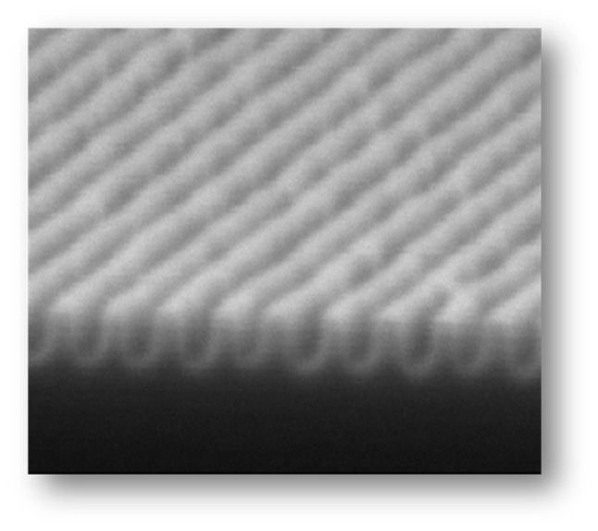
Miracle process flow….. No optics
Substrate
Substrate
Substrate
1. Spin coat BCP
2. anneal
3. Selectively etch one block
10nm lines

Slide 10
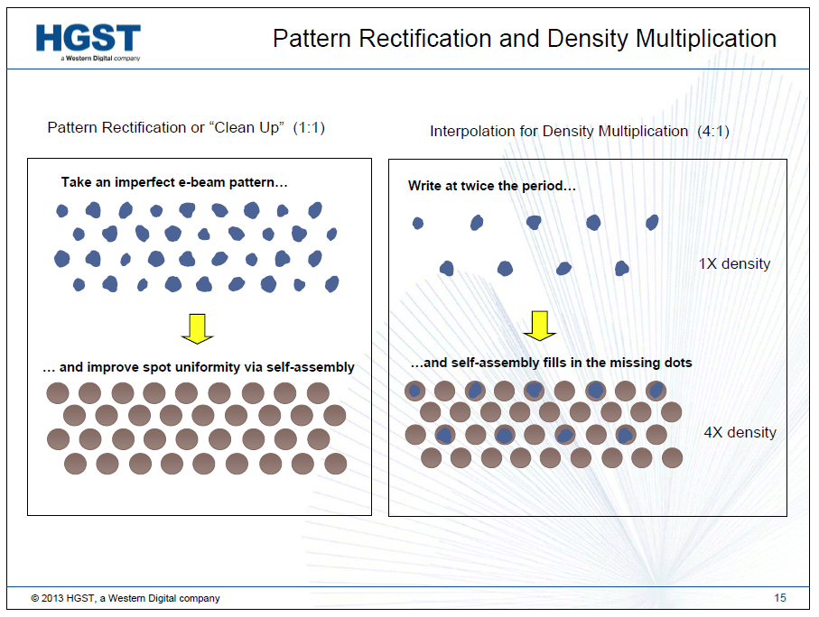
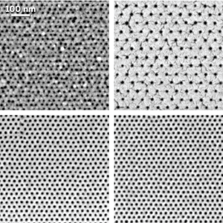
The Miracle of Block Copolymers
1X e-beam pattern
1/4X e-beam pattern
B
C
P
B
C
P
Ricardo Ruiz & Tom Albrecht

Slide 11
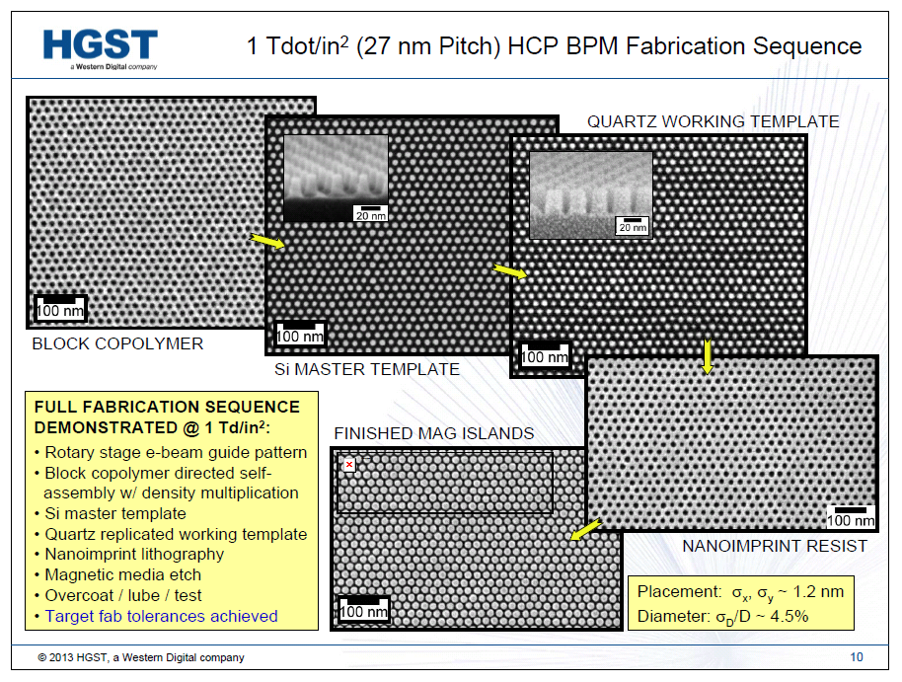
Unfortunately…..not small enough!!!
Resolution limited by the block copolymer
☹

Slide 12
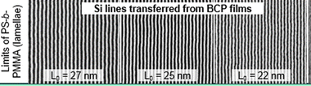
Resolution of PS-PMMA is limited to ca 22 nm by low χ
Goal: Higher resolution than that of PS-PMMA
  High χ ... gives small structures…
Incorporate Si in one block
  This gives high etch contrast
Amenable to orientation and alignment
No new unit processes required for Manufacturing
  No solvent annealing, no “SIS” processing
Poly[styrene-b-methyl methacrylate]
Polystyrene-b-poly(methyl methacrylate)
ACS Nano, 2015, 9 (7), pp 7506–7514

Slide 13
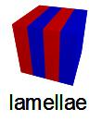
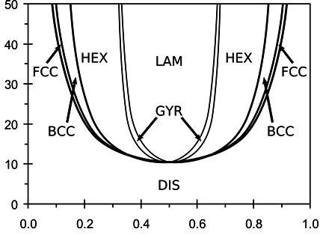
We need high χ and small N
How to Shrink Block Copolymer Domains
A
B
N
Volume Fraction A
Macromolecules 2006, 39, 2449-2451

Slide 14

So…what is this χ thing anyhow??
Flory Huggins Mixing Theory
here χ, the “interaction parameter” describes the enthalpy change due to interspersing the two polymers. It is a function of variables including temperature…..
Polymer pairs with big χ hate each other!!

Slide 15
Design Criteria for New BCP
High χ ... gives small structures
Incorporate Si in one block….. etch contrast
Amenable to orientation and alignment
No new Unit processes required for mfg

Slide 16
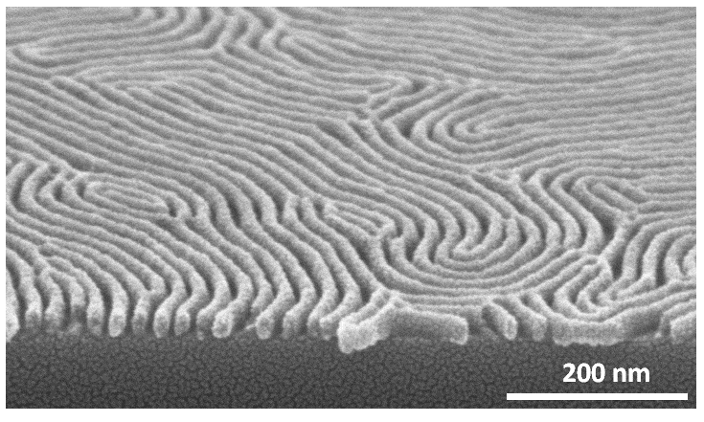

Reactive Ion Etch Development
Oxidizing Conditions
Si 10%
Steve Sirard, Lam
Maher et al. Chem. Mater. 2014, 26, 1471

Slide 17
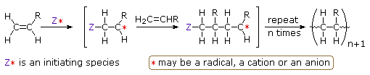
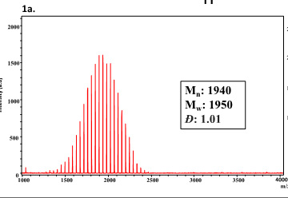

Slide 18
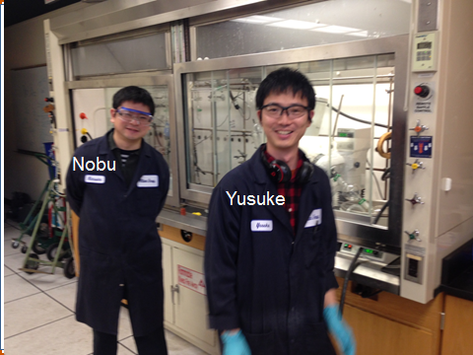
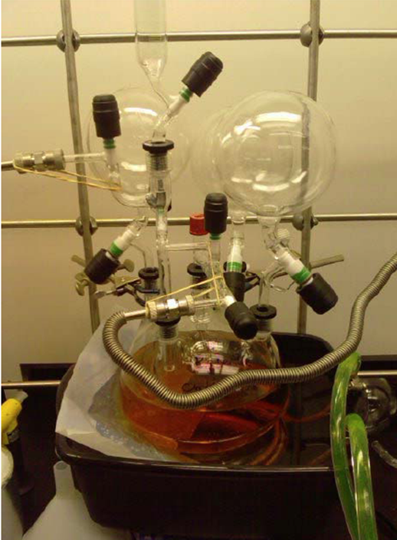


Synthesis challenge → Anionic

Slide 19
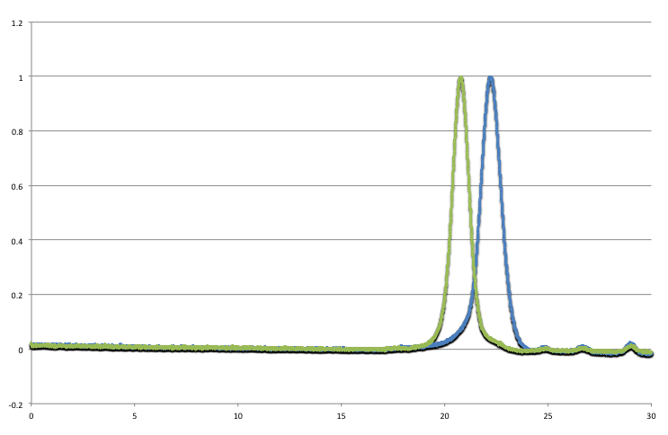
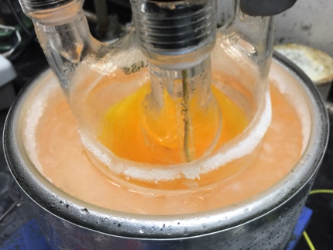
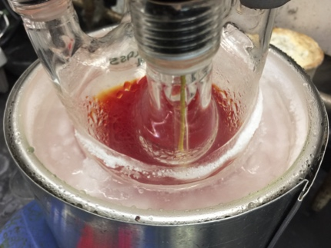
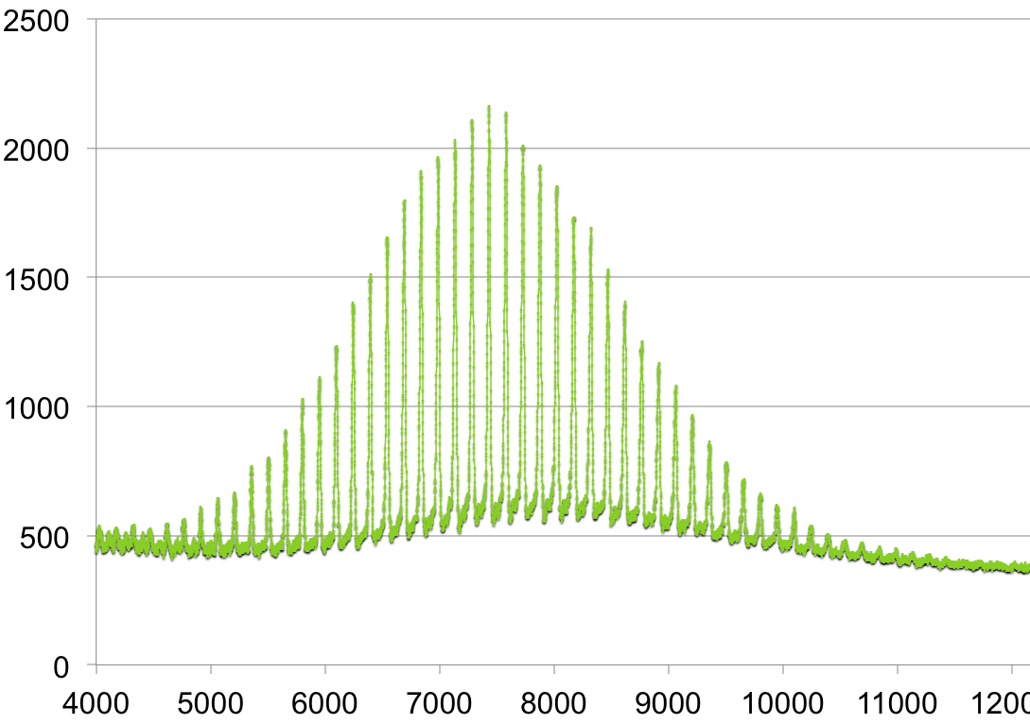
Anionic Polymerization
Aliquot
MeOH
Clear
 | Aliquot | BCP
Mn | 3,997 | 7,677
Mw | 4,261 | 7,924
PDI | 1.07 | 1.03

Slide 20
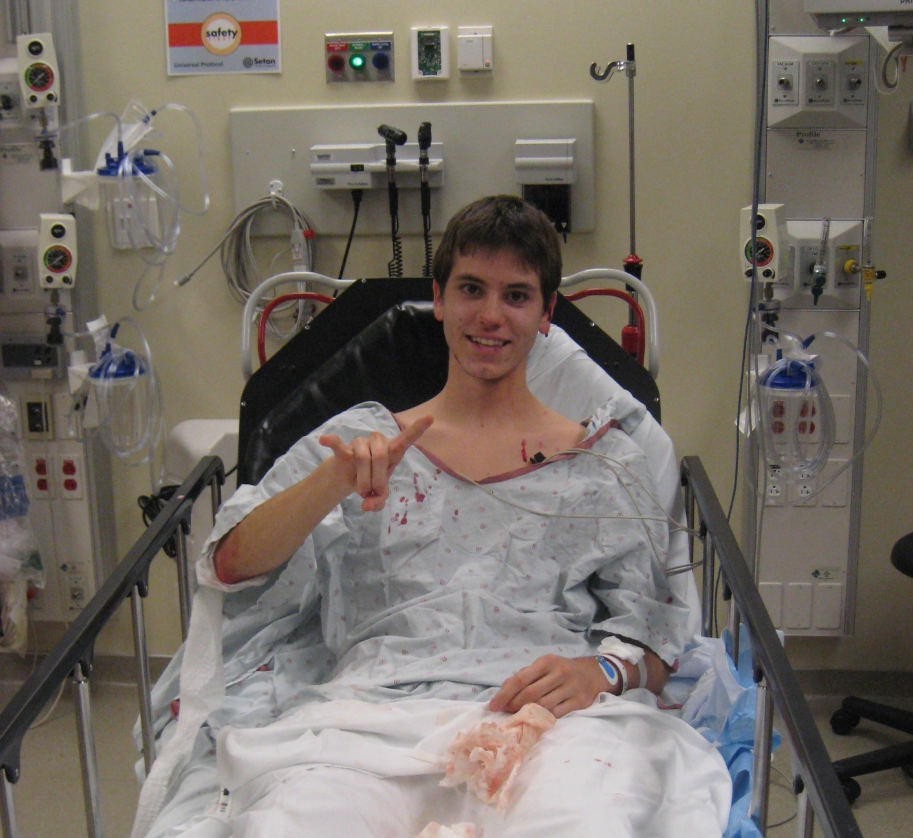
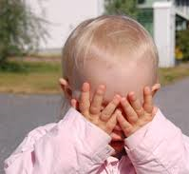

Living anionic is effective but dangerous!

Slide 21
Next….The Orientation Control Challenge
Wafer
Lamellae
Wafer
Bates et al. Science 338, 775 (2012)
Maher et al. Chem. Mater. 2014, 26, 1471

Slide 22
Block Copolymer Orientation
AB diblock
Periodicity “L₀” ~ 5-100 nm
L₀
L₀
Substrate
Substrate
Parallel
Perpendicular

Slide 23
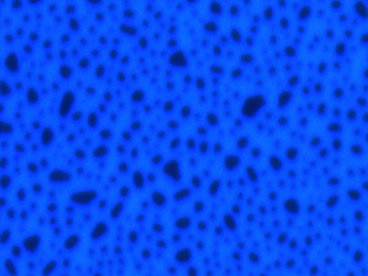
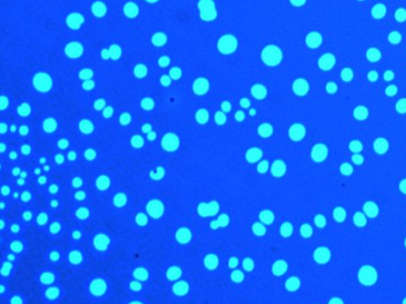
As cast film thickness > L₀?
As-cast film thickness < L₀?
2*L₀
Islands
Holes
1.2*L₀
1*L₀
1*L₀
0.8*L₀
Surface Prefers Red Block
Wafer

Slide 24
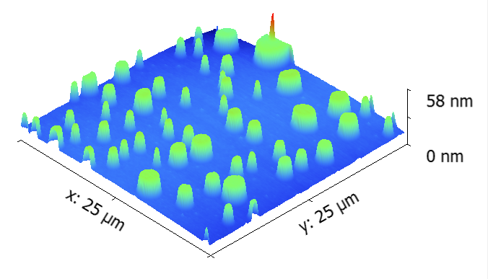
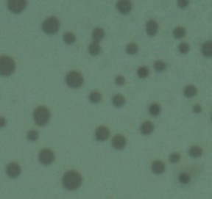
The “island and hole” experiment
Structures are easily seem by optical microscopy
Islands

Slide 25
Si is always on top!
1*L₀
Incommensurate Initial
Film Thickness
1.2*L₀
Which Block Wets?
Wafer
Blue Wets
Red Wets
Islands
2*L₀
Majority
1.5*L₀
Majority
1*L₀
Holes
0.5*L₀
Blue Wets
Red Wets
Wafer
Peters, R. D. et al., Langmuir 2000, 16, 4625.
Wafer

Slide 26
Thin film orientation
Air
Bang et al. Adv. Mater. 2007, 19, 4552

Slide 27
Types of wetting
Red block prefers to interact with the air
n*L₀
(n+1/2)* L₀
PTMSS Preferential Surface
PS Preferential Surface
Symmetric wetting
Asymmetric wetting
Coulon et al., Macromolecules 1989, 22, 2581.
Russell et al., Macromolecules 1989, 22, 4600.
Coulon et al., J. Phys. (Paris) 1990, 51, 2801.

Slide 28
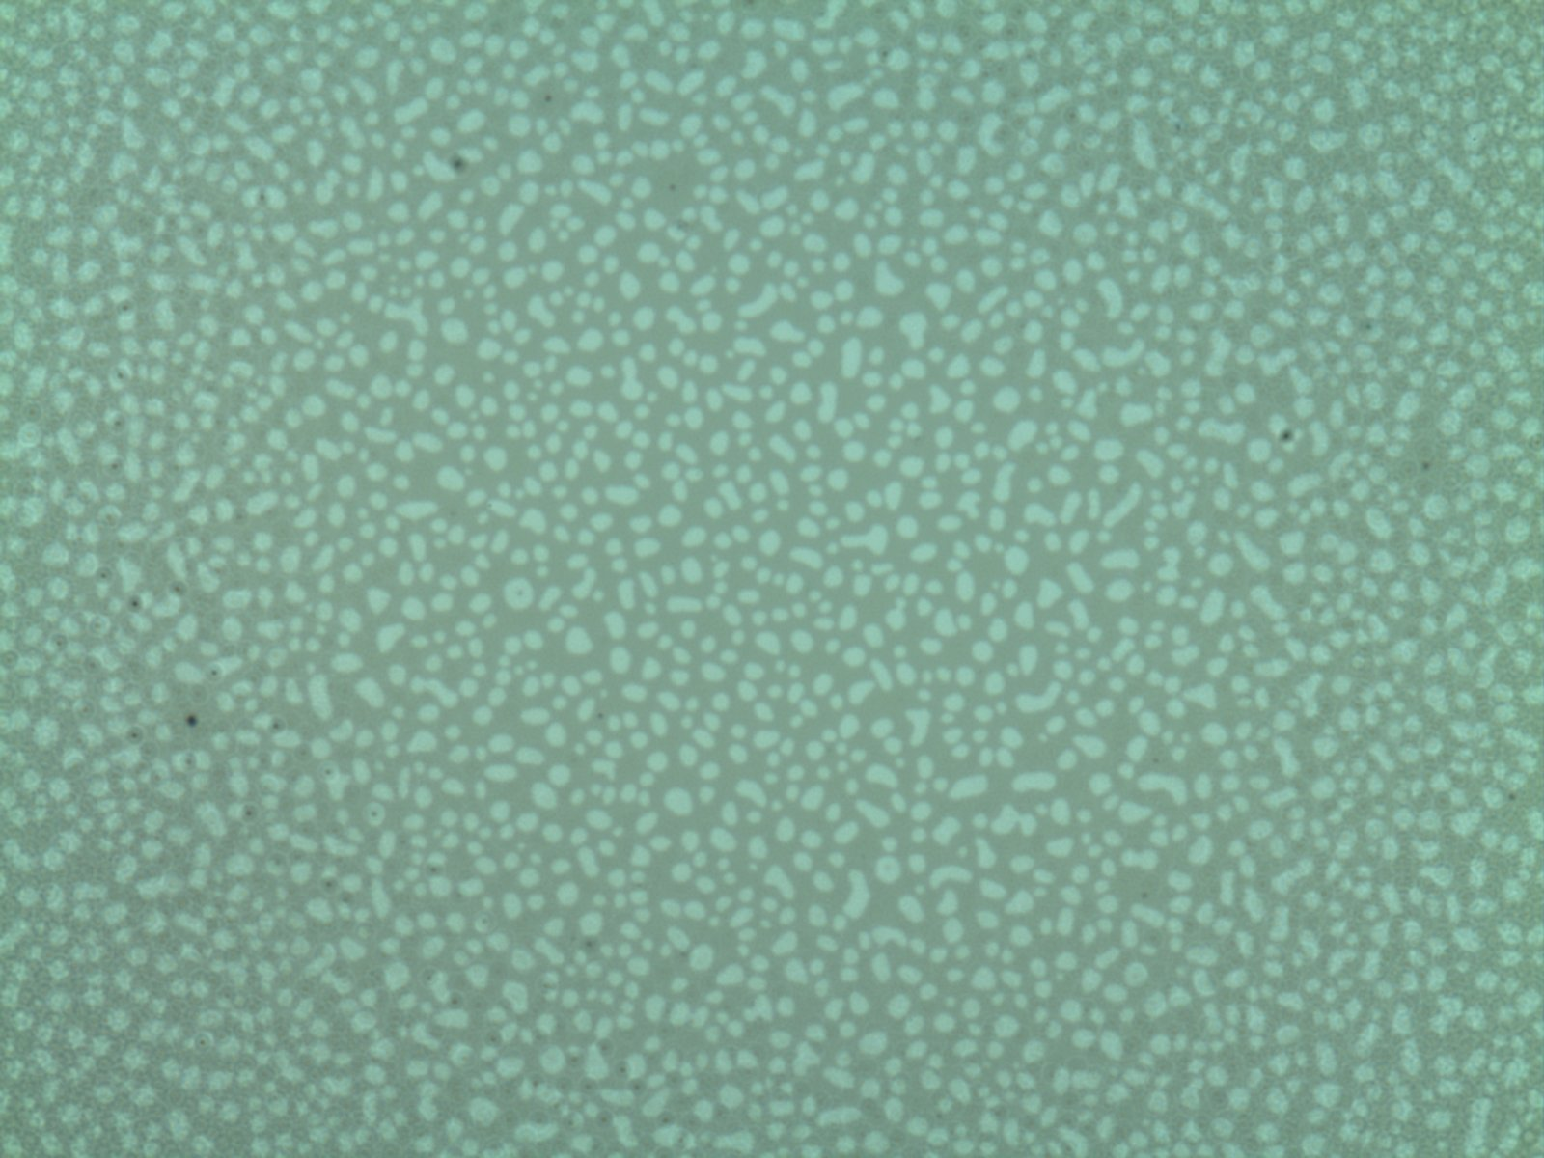
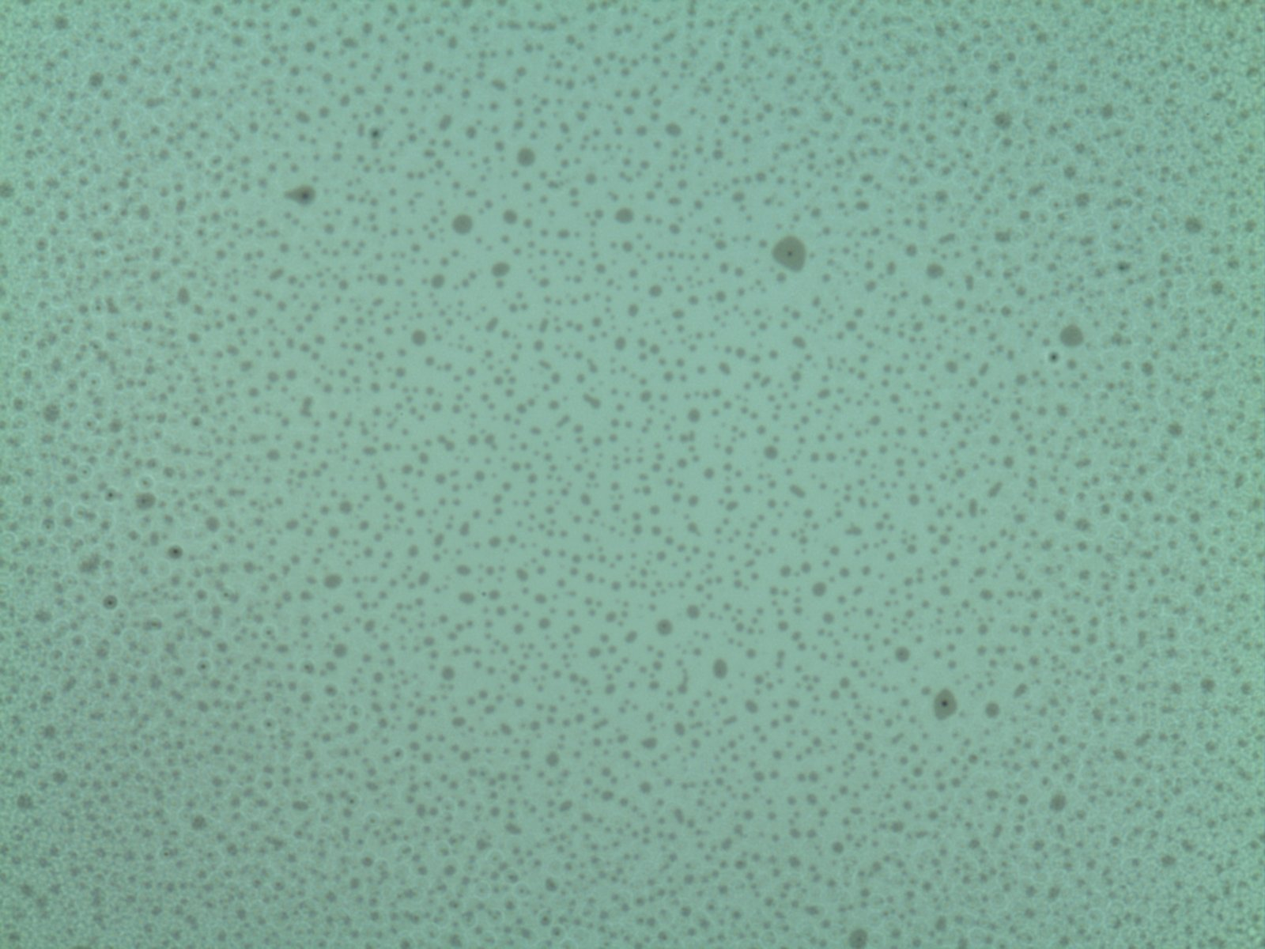
Island / hole analysis
Red block prefers to interact with the air
1 L₀ Holes
1 L₀ Islands
5 µm
1.5 L₀
1.2 L₀
1.0 L₀
100 nm
0.5 L₀
PS Preferential Surface
PTMSS Preferential Surface
Scale bars are 5 µm
Mansky et al., Macromolecules 1997, 30, 6810 , Huang et al., Macromolecules 1999, 32, 5299,. Peters et al., Langmuir 2000, 16, 4625.

Slide 29
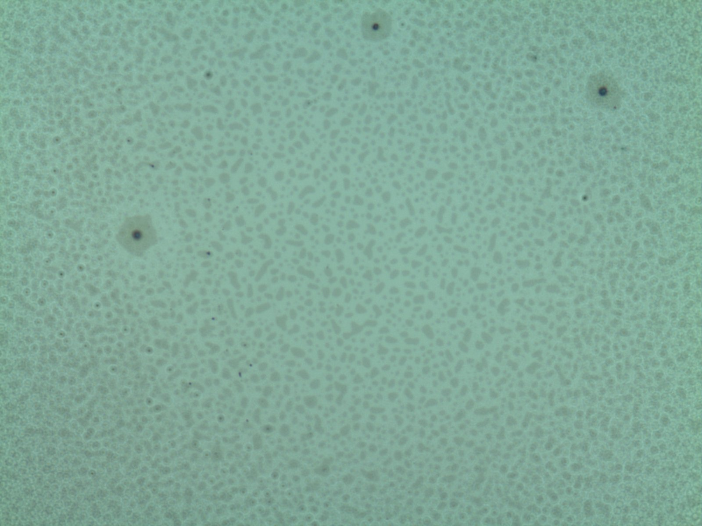
Finding the neutral composition
Surface treatment:
Initial BCB thickness: 1.15 L₀
Percent PtBuS:
48%
52%
65%
Result:
1 L₀ Holes
PS wetting
0.5 L₀ Islands
PS and PTMSS wetting!
1 L₀ Islands
PTMSS wetting
0.5*L₀
?
5 µm
Neutral
Wafer
Scale bars are 5 µm

Slide 30
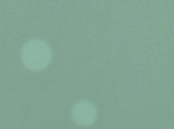
Half L₀ features on a neutral surface
1.17 L₀
0.5 L₀ Islands
1.35 L₀
0.5 L₀ Holes
1.5 L₀
1.25 L₀
100 nm
1.0 L₀
Neutral Surface
Neutral Surface
Kim et al. ACS Nano. 2013, 7, 9905.
Scale bars are 5 µm

